Slide 1
Key Stage 2023
Presented by
Yvonne Callaghan
ICT Development Service
Notes:
Welcome and Intro.
Layout time frame for workshop, hope for a break
Explain reason for “refresher” style workshop

Slide 2
Key Stage
Presented by
Yvonne Callaghan
ICT Development Service
Notes:
Welcome and Intro.
Layout time frame for workshop, hope for a break
Explain reason for “refresher” style workshop

Slide 3
Documentation Centre
Downloading Documentation:
If you subscribe to Welearn365:
http://bit.ly/midaspages
If you do not subscribe:
http://wsd.we-learn.com/downloads
Notes:
For both eoy and key stage

Slide 4
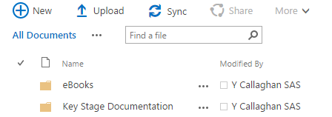
From Midas pages
From the MIDAS home page, click on Documentation, click on Key Stage and all the documents required to complete Key Stage will be available from here.
Notes:
Exp ebooks
Mf may have this included in her pp so it will be a reminder
Exp key stage doc

Slide 5
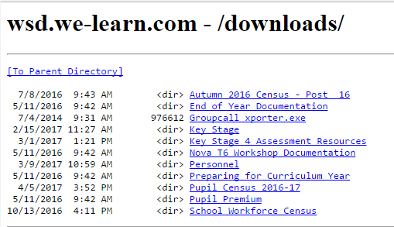
From the Downloads pages
Notes:
Again all the documentation required will be available from here

Slide 6
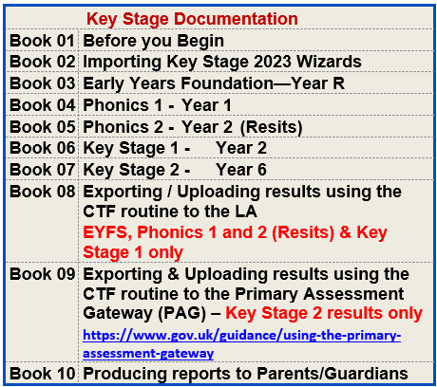
Documentation List – Main Docs
Notes:
Again all the documentation required will be available from here

Slide 7
Documentation List – Appendices
Notes:
Again all the documentation required will be available from here

Slide 8
Key Stage
Please read through:
Book 01 - Before you Begin
This booklet details important changes to key stages this year, together with other relevant information.
Any queries, check the document:
Appendix 7 - I have a problem who do I contact?
Notes:
Key Stage Documentation Check list, please ensure that you have read through the documentation list to ensure you download the appropriation key stage information for your in order fo you to have the appropriate documentation for your school we think that this year the wizards have already been imported, so before importing the wizards just check that they are not already in there.
Read through each section
Please read through booklet 01 Before you begin, its only 7 pages buts it important it will reaffirm the information we go through this morning.
Ensure you have downloaded and imported the Wizards
YC go through the documentation check list and key stage process
Obviously to be able to do this you will need to access the resources
Next slide:

Slide 9
Check List for Completing the End of Key Stage 2023
Import the appropriate Wizards for the school
Tidy up the Wizard Manager screen
Select the appropriate Wizard for the key stage
Select the required group
Open the marksheets for data entry
Change the membership date to pull through leavers (Phonics 1&2 only)
Enter grades/results
Save and calculate the marksheets
Check for missing/incorrect results
Class Teacher and Headteacher to sign off the marksheets
EYFS/Phonics/KS1 – Using the CTF routine, upload results to the LA KS2 – Using the CTF routine, upload results to the Primary Assessment Gateway (PAG)
Print reports for parents/guardians
Upload the reports to the pupils’ records
Notes:
Key Stage Documentation Check list, please ensure that you have read through the documentation list to ensure you download the appropriation key stage information for your in order fo you to have the appropriate documentation for your school we think that this year the wizards have already been imported, so before importing the wizards just check that they are not already in there.
Read through each section
Please read through booklet 01 Before you begin, its only 7 pages buts it important it will reaffirm the information we go through this morning.
Ensure you have downloaded and imported the Wizards
YC go through the documentation check list and key stage process
Obviously to be able to do this you will need to access the resources
Next slide:

Slide 10
Note to Academies / Free Schools
Academies, whether or not, have nominated Warwickshire County Council to be their monitoring/moderation LA for 2023, will still need to upload their EYFS, Phonics 1, Phonics 2 and Key Stage 1 results using the guidance available to Warwickshire County Council to complete data checks before submission to the DfE
https://apps.warwickshire.gov.uk/SchoolUpload/
This system is used termly to upload the School Census files to the LA. Any difficulties at all with uploading the file, please email: businessintelligence@warwickshire.gov.uk
Key Stage 2 results should be uploaded to the Primary Assessment Gateway
https://www.primaryassessmentgateway.education.gov.uk
Notes:
https://apps.warwickshire.gov.uk/SchoolUpload/
This system is used termly to upload your School Census files to the LA. If you have any difficulties at all with uploading your file, please email: insight@warwickshire.gov.uk

Slide 11
Note to Academies / Free Schools
May Summer School Census 18th May 2023 – Request from the Assessment Unit:
Academies and Free schools have a different submission date that they can submit their census data. However, the census is still undertaken on Thursday 18th May.
It would enormously benefit the Assessment Teams data checking if Academies and Free schools would be willing to submit their census data on the same day as maintained schools.

Slide 12
Missing Pupils
Children in Reception, Y1, Y2 or Y6 who are on roll but not attending school:
These cases must be resolved well before submission date in June.
Please refer to Book 01 Before you Begin, Missing Pupils page 7 for further advice and who to contact.

Slide 13
Phonics 1 and 2 - Leavers
Schools are required to include pupils who have left the school. The Assessment Team will give guidance as to which pupils to include. These pupils will need to have a code of L – Left recorded in the marksheet. These pupils will also need to be included in the CTF along with current pupils when uploading results to the LA/School Upload for Phonics 1 and 2
Notes:
Explain second para, marks can be entered into a pupils records for pupils who are absent right up to the 23 June . 23rd June will be the final date for uploading the results to the LA, repo
Explain the rest
Last para there will be no need to re upload the results to the la as asessment team will be able to work out the marks

Slide 14
Year 2 - Phonics Screening- Resits Year 2 2023
Resits are for pupils who were either absent, or did not achieve a ‘Wa’ grade when the tests were taken last year when pupils were in year 1. Year 1 Phonics Screening 2022). Book 05 will guide schools through the process of identifying current year 2 pupils who need to resit the test.
Notes:
Explain second para, marks can be entered into a pupils records for pupils who are absent right up to the 23 June . 23rd June will be the final date for uploading the results to the LA, repo
Explain the rest
Last para there will be no need to re upload the results to the la as asessment team will be able to work out the marks

Slide 15
Important –Phonics Years 1 & 2
2023 YEAR 1 AND YEAR 2 PHONICS – RELEASE OF THRESHOLD MARK
The threshold mark (pass mark) for Phonics will be disclosed on Monday 26th June 2023
IMPORTANT: Please Note!
The Assessment team have requested that schools upload their data via the CTF routine using the current phonic wizard by Friday 23rd June without the threshold mark entered.
Once data has been uploaded to the LA, schools will then be able to enter the threshold mark on 26thJune 2023, and then produce reports to parents/guardians.
Notes:
Explain second para, marks can be entered into a pupils records for pupils who are absent right up to the 23 June . 23rd June will be the final date for uploading the results to the LA, repo
Explain the rest
Last para there will be no need to re upload the results to the la as asessment team will be able to work out the marks

Slide 16
Important –Phonics Years 1 & 2
Schools do not have to re-send the results to the LA
Notes:
Explain second para, marks can be entered into a pupils records for pupils who are absent right up to the 23 June . 23rd June will be the final date for uploading the results to the LA, repo
Explain the rest
Last para there will be no need to re upload the results to the la as asessment team will be able to work out the marks

Slide 17
Key Stage 1 & Key Stage 2 Changes Removal of ‘D’ (Disapplied)
Removal of ‘D code’ for KS1 and KS2 teacher assessment. The ‘D’ code, originally used to record where a pupil was ‘disapplied’ from the national curriculum assessments, has been withdrawn for KS1 & KS2 Teacher Assessment marksheet.
Headteachers make the final decision about whether it is appropriate for a pupil to take the check. In any instances when pupils are not entered for the check, schools should explain their decision to the pupil’s parents.

Slide 18
Key Stage 2 Results
A change to the KS2 test schedule this year will be necessary due to the additional bank holiday in honour of the Coronation of His Majesty King Charles III taking place on Monday 8 May 2023. Further information may be found on the following website.
https://www.gov.uk/government/news/changes-to-key-stage-2-assessment-dates-in-2023

Slide 19
Key Stage 2 – Pupils who change schools
Information taken from the Assessment and Reporting arrangements (ARA) DfE website: https://www.gov.uk/government/publications/2023-key-stage-2-assessment-and-reporting-arrangements-ara
If a pupil changes school:
before test week – the receiving school must submit TA data for them
during test week – the school where the pupil was registered at the beginning of test week must submit TA data for them
after test week – the school where the pupil was registered during test week must submit TA data for them
If a pupil arrives during test week from a non-participating school or having been electively home educated (EHE), the receiving school must submit TA data for them.
If the pupil arrives after test week, they can no longer be registered for the tests, so data will not be expected
For more information, schools should contact in the first instance the Primary Assessment Gateway (PAG)

Slide 20
Key Stage 2 Results
Schools will be able to:
upload Key Stage 2 Teacher Assessment results via CTF to the following website:
https://www.primaryassessmentgateway.education.gov.uk/
Once the results have been checked and verified, Test Outcomes will be produced by the PAG, schools will be able to download from the above website the Key Stage 2 Test Outcomes from 7:30 am on the 11th July 2023

Slide 21
Key Stage – Reminders:
Check for Missing Results – Please do not upload files with missing results, only one file per key stage may be submitted.
Remember if changing any results in the marksheet the marksheet must be calculated and saved
Teachers & Headteachers will need to check/sign off marksheets
Upload results for EYFS, Phonics 1&2 and KS1 to the LA via CTF to:
https://apps.warwickshire.gov.uk/SchoolUpload
Upload Key Stage 2 results to the: Primary Assessment Gateway (PAG)
https://www.primaryassessmentgateway.education.gov.uk/
Notes:
If you upload a file with missing results either to the NCA tools website (KS2 or the, someone from the LA will contact you to enter missing results and you will have to calculate the mshet again and upload the whole ctf including the pupils you had already sent, if you have any issues with missing entries, youmust contact Debbie Hibberd. Her contact information is in the attached documentation.
Hence that’s why we ask you to get your teachers to sign off the marksheets and your head teachers to reiterate that there are no missing pupils or missing entries before the results are uploaded to the LA.
It also covers admin staff if they have been asked to enter results that the teacher and ht has checked and validated them.
Don’t send files with missing results
Only one file per key stage may be sent up to the la
Eg you cant send one file, then realise you missed a pupils results, then just send them separately you have to include them in the original group
You will get phone calls from Assess team asking you to enter a mark then calculating, saving,

Slide 22
Key Stage Return Dates
EYFS
Data Collection opens - 5th June 2023
Data Collection closes - 27th June 2023
Phonics Year 1 & Year 2
Data Collection opens - 12th June 2023
Data Collection closes - 23rd June 2023
Key Stage 1
Data Collection opens - 5th June 2023
Data Collection closes - 27th June 2023
Key Stage 2
Data Collection opens - 15th May 2023
Data Collection closes - 30th June 2023
Notes:
Yc need to change dates

Slide 23
Important
Uploading Key Stage 2 results to the Primary Assessment Gateway:
Ensure the person holding the password for the Primary Assessment Gateway site is present on the day the results are to be uploaded.
Neither the Assessment or the MIDAS teams will have that information for schools when uploading data to the Primary Assessment Gateway site.

Slide 24
End of Key Stage Process
When all the:
Results have been entered, verified
Data uploaded to the LA or PAG website
Reports have been printed and sent to parents
Schools will be able to upload all pupil Key Stage results to the pupil’s Linked Documents within their pupil record. This is useful for future reference.
Guidance on how to do this is in the appropriate Key Stage manual.

Slide 25
User Assessment Defined Groups
Creating a User Defined Group:
Pupil out of year e.g. Year 3 aged pupil who is in Year 2.
Phonics year 2 pupils (Retakes)
See Appendix
A1 – Creating User Defined Groups
Notes:
Explain ALL pupils will need to have a result entered.
For the year 2 Phonics group I will show you how to just select those pupils and it is in your books

Slide 26
Methods of Entering Results into Marksheets
SIMS in the Classroom
Exporting marksheets to a shared area in order for teachers to enter marks directly into marksheets
Export marksheets to Excel and print for teachers?
Admin Staff entering results
Check appropriate appendices for guidance
Notes:
Refer to Appendices that are available on both of the websites mentioned.

Slide 27
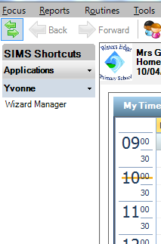
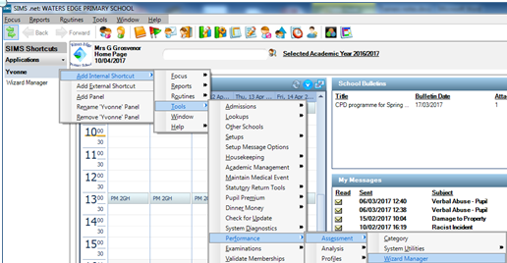
Shortcut Panel
From the Home Page:
Click on the double green arrow to display the SIMS shortcuts panel
Click on the Down arrow next to Applications
Add a Panel and enter your name.
Click on the down arrow next to your name and select Add Internal Shortcut
Navigate to Tools / Performance / Assessment / Wizard Manager
To close the shortcut panel, click on double green arrow
Notes:
Explain you can do this for any shortcut you use in SIMS eg running you registers you set up an internal shortcut, saves going through the long route
Ill show you how to do this once in SIMS
Apologies if you know this already, but you may find it useful

Slide 28
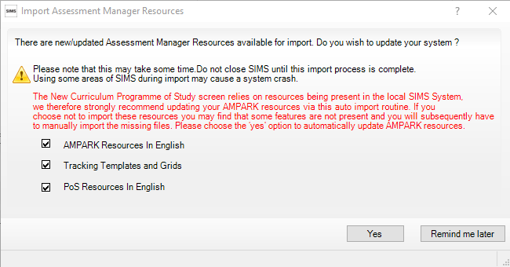
Notes:
Showing you this now as you

Slide 29
