Slide 1
Post 16 Workshop 2023
MIDAS Team
Heather Tzemis

Slide 2
Rationale for Workshop
The Education and Skills Funding Agency (ESFA) requires learning aim information to be submitted via the Autumn Census return for schools with Post 16 students.
This information is used to calculate sixth form funding and qualification success rates (QSRs).

Slide 3
MIDAS Documentation available from:
http://bit.ly/midaspages OR http://wsd.we-learn.com/downloads
Post 16 Preparation Checklist Autumn Census 2023
Preparing Post 16 Data School Census Autumn 2023
Managing Post 16 Learning Aims with Scenarios
Managing Course Manager
Post 16 Census Workshop 2023 (Presentation)

Slide 4
Workshop Format
Presentation - discussing the elements comprising Post 16 Learning Aims and how other data areas impact on these Learning Aims and thereafter the Autumn Census return
Demonstration - in SIMS of Learning Aims elements and a census run

Slide 5
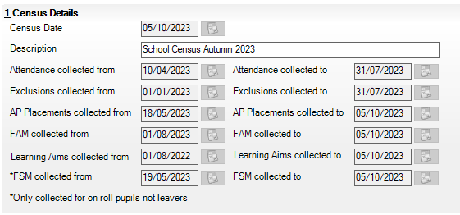
Autumn 2023 Census Dates

Slide 6
For which students is Post 16 data collected?
Current Academic year 2023/24
Students who have been on roll at any point between 01/08/2023 & 05/10/2023 with a Learning Aim in National Curriculum Year 12 or above (regardless of the students age).
Previous Academic year 2022/23
Students who have been on roll at any point between 01/08/2022 & 31/07/2023 with a Learning Aim in National Curriculum Year 12 or above (regardless of the students age).
IMPORTANT NOTE: Courses for students in Year 11 must be ended before the 1st August so that they are not confused with qualifications for Year 12 and above.

Slide 7
What Learning Aims data is collected?
AO QN & SCC – Where a result exists
Awarding Organisation Qualification Number & Subject Classification Code formerly known as a Discount Code
QWS QN & SCC - Where no result exists
Qualification Accreditation Number & Subject Classification Code formerly known as a Discount Code
Learning Aim Dates (Start date, Planned End date and Actual End date)
Status of Learning Aim (Continuing, Transferred, Withdrawn)
Withdrawal Reason
Qualification & Non qualification hours
Core Learning Aim where applicable

Slide 8
What Learning Aims data is collected?
Prior Attainment (English and Maths GCSE) – Current & Previous academic year
Employment Indicator
Partner UKPRN (United Kingdom Provider Number)
Traineeship Details
Industry Placements, integral part of T Level programmes (Schools in receipt of Industry Placement Capacity & Delivery Fund)
NOTE: All Learning Aims are collected regardless of their duration, provided the dates are within the designated collection period of 01/08/2022 to 05/10/2023.

Slide 9
Over what period of time is data collected?
It is useful to consider the post-16 return as two collections at one point in time:
Previous academic year |  |  |  |  |  |  |  |  |  |  |  | Current academic year
September | October | November | December | January | February | March | April | May | June | July | August (Results) | September | October (Census ) | November | December | January | February | March | April | May | June | July
Learning aims for completed and continuing courses. Exam (AO) QN and Discount Code or QWS QAN and Discount Code, start date, actual end date, planned end date, planned qualification or non-qualification hours, core learning aim for student on a vocational or mixed programme, Traineeship Indicator, UKPRN if applicable, prior attainment data in English and maths and status, where status is completed. QWS QAN, withdrawal reason, start date, actual end date, planned end date, core learning aim for student on a vocational or mixed programme, prior attainment data in English and maths. UKPRN if applicable, Traineeship Indicator and status, where status is not completed. |  |  |  |  |  |  |  |  |  |  |  | Learning aims only for year 12 and above. (QWS QAN and Discount Code, start date, actual end date, planned end date, status, withdrawal reason, planned qualification or non-qualification hours for current and previous academic year, core learning aim for student on vocational or mixed programme), Traineeship indicator and UKPRN if applicable. Prior attainment data in English and maths for current and previous academic year. T Levels related data items includes Pupil Programme Aims data items, Pupil Planned Hours data items and Learning Aim Placements data items.

Slide 10
Use of Course Manager
Course Manager enables schools to accurately maintain Learning Aims data throughout the school year.
Please try not to leave it all until
just before Census day!

Slide 11
What is a Course?
A course is a subject being studied at a particular level.
As well as Subject, Level and Memberships, courses also hold information on;
Planned Qualification and Non-Qualification Hours
Nationally recognised Qualification Numbers (QNs, previously known as QANs)
Links to Exam Basedata
Course Supervisors and Teachers
13A/Ma1
+
GCE2Y
13A/Ma2
+
GCE2Y
Maths GCE2Y Full Course
=
13B/Ma1
+
GCE2Y
13B/Ma2
+
GCE2Y

Slide 12
What use is made of courses?

Slide 13
How are courses created in SIMS?
Courses can be created in two different ways:
Automatically:
Where the Level and Subject codes assigned in Nova T6 and Course Manager match
Manually within Course Manager:
Non-timetabled courses (Twilight)
Work Experience, Duke of Edinburgh, Supervised Study
Science, may need separate Biology, Chemistry & Physics
Incorrect level assigned in Nova T6

Slide 14
Who needs to be involved?
Task | Roles
Clear information available to the exam officer regarding which exam awards students are working towards across the curriculum. This is to ensure that the exam officer has the information needed to download appropriate basedata. | Head of department, curriculum head, exam officer.
Accurate allocation of exam levels to classes in the timetable before the start of the new academic year for the transfer to SIMS | Timetabler, curriculum head, exam officer.
Accurate management of basedata and linking of certification awards to courses. | Exam officer, academic manager, data manager/SIMS manager.
Ensuring that all courses required are available in SIMS Course Manager. | Curriculum head, exam officer, academic manager, SIMS manager/data manager.
Allocation of students to academic classes and on-going changes to class membership. | Academic manager, data manager/SIMS manager.
Management of course memberships/exceptions. | Academic manager, data manager/SIMS manager
Creation and checking of the autumn school census. | Curriculum head, data manager/SIMS manager.

Slide 15
Study Programme Planned Hours
Education & Skills Funding Agency Guidance
All students aged 16-19 are expected to follow a Study Programme (academic or vocational) tailored to prior attainment & future career aspirations (In school likely to have ILR – Individual Learner Record). Students study: one or more substantial qualification, undertake a traineeship or, do substantial work experience.

Slide 16
Study Programme Planned Hours
Education & Skills Funding Agency Guidance
‘Planned hours are a fundamental element in the funding allocation process which uses data recorded in the Individualised Learner Record (ILR) and the school census. They are used to determine the proportion of students in each funding band which, in turn, determines the national funding rate per student. Errors in recording planned hours are likely to have an impact on an institution’s allocated funding. Accurate recording of planned hours is essential to ensure an institution’s funding allocation is calculated correctly.’

Slide 17
Study Programme Hours
Planned Hours funded by the Education & Skills Funding Agency
Must be recorded accurately in SIMS - used to calculate future funding allocations
Qualification Hours
Hours of teaching and learning that count towards externally certified qualifications that are approved for teaching to 16 to 19 year olds under Section 96 (qualifications that are not approved under Section 96 cannot be taught in schools).
Non Qualification Hours
Hours of fundable activity that are not used to take externally certified qualifications. These hours are also known as planned employability, enrichment and pastoral (EEP) hours.

Slide 18
Funded Qualification Hours
Count towards externally certified qualifications Timetabled Organised and/or supervised by the institution Examples: Planned tutor led activity on courses leading to qualifications Planned hours of tutorial, work experience or work preparation Planned hours on other activities relevant to the student’s study programme, organised and provided by the institution, such as sport or volunteering

Slide 19
Funded Non-Qualification Hours (EEP)
Do not count towards a qualification – are for informal or in-house certificates Timetabled Organised and/or supervised by the institution Are for tutorial purposes Work experience, volunteering and/or community activities organised by or on behalf of the institution Examples; Tutorials/one to one sessions such as to plan study or revision Mentoring and coaching Structured revision Informal certificates such as Citizenship or Duke of Edinburgh Award
https://www.gov.uk/guidance/16-to-19-funding-planned-hours-in-study-programmes#includes-hours

Slide 20
Non Funded Hours
EFSA will not fund hours that are not: Timetabled Organised and/or supervised by the institution Nor will they fund: Voluntary extra-curricular activities and clubs delivered during breaks or outside the normal working pattern Study that is homework or independent study/research that is not timetabled Time spent in employment and or work experience organised by anyone other than the school Time spent on volunteering and/or community activities organised by anyone other than the school

Slide 21
Post 16 Programme of Study
Tools | Academic Management | Course Manager | Post 16 Programmes of Study
To update Hours from Courses
To update Programme Type

Slide 22
Post 16 Prior Attainment
Concerns
The ESFA can withhold all funding for a post-16 student where the school has not adhered to all the rules regarding prior attainment at GCSE in Maths and English as reported in School Census Autumn for that student
Reformed GCSE (9 to 1) grades can exist alongside the previous GCSE grades 9 to 4 or A* to C are acceptable grades 3 or D will normally mean staying with GCSE
The highest prior attainment in the previous academic year will also be collected to enable corrections to be reported.

Slide 23
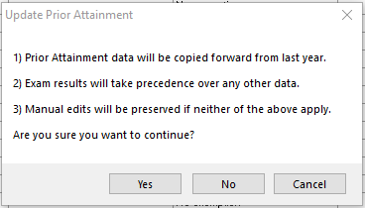
Post 16 Prior Attainment
Tools | Statutory Returns Tools | Update Prior Attainment

Slide 24
Core Learning Aim
The Core Learning Aim has 2 main functions:
For the study programme: the core aim focusses on the student’s aspirations and goals for the future and defines the main purpose of the student’s study programme.
For funding purposes: the core aim has a significant impact on funding allocations. It is vital for calculating retention and to determine the programme costs weighting applied to the study programme.
If a core aim is not returned for a student in the Census, their programme will be deemed Academic.
If the student’s core aim is NOT listed below, the student’s programme is VOCATIONAL.
 | Core aims in academic programmes
Level | Qualification types
3 | GCEs: A levels and AS levels; double awards count as two academic qualifications IB Diploma. IB Certificates. Cambridge Pre-U Diploma. Access to HE Diploma.
2 | GCSEs – including vocational. GCSE short courses. Free standing maths qualifications (FSMQs).
https://www.gov.uk/guidance/16-to-19-funding-core-aims-in-study-programmes#core-aims

Slide 25
Qualification (Accreditation) Numbers = £ £ £’s
QAN Type | Description | Available from | Required for
QWS QAN | QWS web service QN. | QWS website for download into SIMS. | All learning aims without a result from the awarding body including: Take up of new courses. Courses with a status of Withdrawn, Transferred or Continuing Completed or School Assessed.
AO QN (Each QN represents the board, level and broad subject) | Awarding organisation QN. | Exam boards and basedata for import into SIMS. | All learning aims with a result from the awarding body.

Slide 26
Other considerations…
Dual registered students
Only report Learning Aims for Single Registration and Main–Dual Registration students
Re-sits
Learning Aims are not collected as part of the Post 16 Census as they are not funded.
Re-takes
Re-takes are NOT generally eligible for funding as funding for tuition and taking of exams, has already been given. In Course Manager, a tick should be entered in the ‘Not Funded’ column of the Memberships and Results Panel, unless: There are exceptional circumstances Long term sickness or educational reasons in which case funding can be claimed. (See Funding and Monitoring Table for student’s repeating Year 13) GCSE English and Maths retakes Where a student has not achieved grade 4 to 9 in these subjects, they are not treated as a retake for funding purposes. Therefore Planned Hours should be included for these in the course.

Slide 27
Other considerations…
Two Year Courses
Need to be recorded with an appropriate duration in SIMS as part of the course setup The Planned End Date should show that the course is expected to last for two years At the end of year one, the learning aim status of Continuing would demonstrate that a result is not expected for this student Planned qualification and non-qualification hours for a study programme spanning more than one year should only have the planned hours recorded for each separate year of data.
UKPRN (UK Provider Reference Number)
Any Post16 learning aims, where the learning is provided other than at the school, includes a UKPRN to identify the provider An 8 digit number maintained by the UKRLP (UK Register of Learning Providers) Schools can search for UKPRNs on the UKRLP website https://www.ukrlp.co.uk or Get Information about Schools website. https://www.get-information-schools.service.gov.uk

Slide 28
Other considerations…
Year Group and Year Taught In
Important to check this information is stored correctly in SIMS.
Withdrawal Reason
The DfE requires that any Post 16 Learning Aim from which a student withdraws, must include a Withdrawal Reason. (A list of acceptable Withdrawal Reasons is detailed in the Course Manager & Post 16 Learning Aims book)
Traineeships
Traineeships are designed to help young people who want to get an apprenticeship or job but don’t yet have appropriate skills or experience. Traineeships are a demand led programme which can benefit young people if they are within six months of being able to get sustainable employment or an apprenticeship. It will be very rare for a school to have students on a traineeship.

Slide 29
Other considerations…
T Levels
Equivalent to 3 A Levels, these 2-year courses have been developed in collaboration with employers and businesses so that the content meets the needs of industry and prepares students for work. Industry placements will form an integral part of the T Level programme and have been added to the QWS. Schools in receipt of industry placement Capacity and Delivery Fund will record industry placements using one of the 16 industry placement learning aims found on QWS.
Timeline
First T Level programmes start for specific occupations in 3 industries: Digital production, design and development (digital industry) Design, surveying and planning (construction industry) Education (education and childcare industry) https://www.gov.uk/government/publications/introduction-of-t-levels/introduction-of-t-levels

Slide 30
Exams basedata structure
Basedata structure
Well managed basedata structure is a consideration for: Post-16 learning aims data stored in Course Manager, but also for: Creation of Exam Marksheets (Examinations Organiser) Exams Analysis (Examinations Organiser) It is good practice (but not essential) to aim for a 1:1 ‘Course/Exam Award’ relationship.

Slide 31
Course/Exam Award relationship
Curriculum
Exams
Elements
Class 1
Unit 1
Unit2
Class 2
Course
Award 1
Unit 3
Unit 4
Class 3
Certification 1
Unit 1
Award 2
Unit 2
Certification 2

Slide 32
Post 16 Pupils in Full-Time Employment
Student Record | Additional Information panel
Working 8 or more weeks consecutively and for 20 or more hours per week DURING SCHOOL HOURS
Exclusion of weekend and evening work makes this much less of an issue for most schools

Slide 33
ESFA Post 16 Funding
Starting next year’s curriculum early
‘Is there any impact on funding for courses that start on 1 June, as the ESFA academic year starts on 1 August?’ YES! ‘Schools are unlikely to receive any extra funding if they start activity for Year 12/13 students before the start of the academic year’. In fact, your funding could be reduced as courses may be treated as completed early!

Slide 34
Managing class/course memberships
Curriculum Assignment by Student
Use Curriculum Assignment by Student when sixth form students CHANGE learning aims (classes) and ensure that the end date is the system date or a date in the past. You will then be prompted when clicking on Save to manage the learning aims at the same time.
Leavers Routine
Use the Leavers Routine when sixth form students LEAVE school mid year too, and ensure that the correct withdrawal reason is entered. You will then be prompted when clicking on Save to manage the learning aims at the same time.

Slide 35
Attendance for Year 11/13 Students
The DfE’s advice regarding study leave is that it should be used sparingly and only granted to year 11 students during public examinations. As study leave is unsupervised, schools must record it as Attendance Code S - Study leave (authorised absence). Schools should not continue to grant study leave when examinations are finished. The official school leaving date is the last Friday in June, in the school year in which a child reaches the age of 16. Secondary Schools with Post 16 should enter the S code - Study leave for year 11 students during the examination period. Thereafter, authorised absence should be entered until the last Friday in June in the school year in which a student reaches the age of 16. Thereafter, until the end of the term in July, the X code can be used to signify non-compulsory school age. Please do not enter leaving dates for year 11 students until the next academic year when you will have a definitive list of which year 11 students have continued into year 12. Secondary Schools without Post 16 should enter the code S-Study leave for year 11 students during the examination period. Thereafter authorised absence should be entered until the last Friday in June.

Slide 36
Course Levels in the Timetable and Course Manager
Levels are not collected by the Census Correct levels make management of courses a lot easier Importing any new levels into Nova-T6 and then exporting classes with this level before the start of Academic Year 2022/2023 creates different courses for the old and new levels for a subject, which means: classes are linked automatically to the right courses the appropriate QN can be indicated for the course the appropriate Exam Award can be indicated for the course. If schools do not make use of a new Level for export from Nova-T6 to SIMS, a new course can be manually created but links to automatic updates will be lost.

Slide 37
Course Levels, Course Management and Exams
GCE2Y – 2 year A level
GCE Advanced 2 Year course
GCAS1 – 1 year co-teachable AS level
GCE Advanced Subsidiary Revised
GCSNF – 2 year GCSE
GCSE Full Course

Slide 38
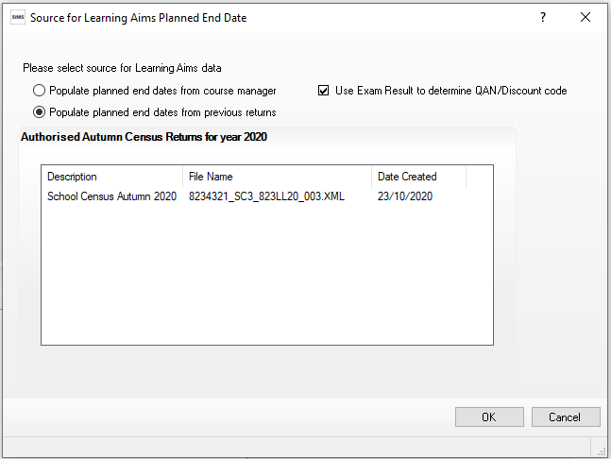
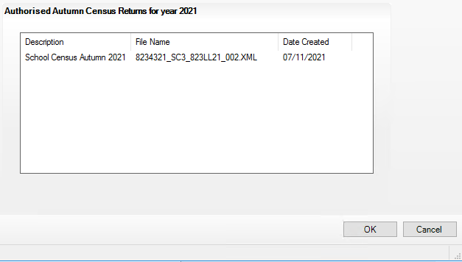
Running the Census
Ensure the Populate planned end dates from course manager option is chosen.

Slide 39
Useful Links
Completing the School Census DfE Guide:
https://www.gov.uk/guidance/complete-the-school-census
Post 16 School Census Interactive Tool 2023 to 2024
https://www.gov.uk/government/publications/interactive-post-16-school-census-tool-2023-to-2024
ESFA Funding Guidance:
https://www.gov.uk/guidance/16-to-19-education-funding-guidance
DfE QAN Web Service(QWS):
https://collectdata.education.gov.uk/qwsweb/default.aspx
Funding Education for 16 to 19 year olds https://www.gov.uk/government/collections/funding-education-for-16-to-19-year-olds

Slide 40
Useful Links
DfE Section 96 Qualifications (approved for funding):
http://www.education.gov.uk/section96
OFQUAL - Register of Regulated Qualifications (Qualification hours):
http://register.ofqual.gov.uk
LARA – Learning Aim Reference Service:
https://data.gov.uk/dataset/6f979630-d806-4641-9a89-acf1d3b66a31/learning-aim-reference-service
UKRLP Website – UKPRN:
https://www.ukrlp.co.uk

Slide 41
Let’s look at SIMS…

Slide 42
Any Questions?
Documentation available from:
MIDAS pages on WeLearn Portal (http://bit.ly/midaspages)
Downloads Website (http://wsd.we-learn.com/downloads)

