Slide 1
Pupil Census January 2024
Heather Tzemis

Slide 2
Aims
Overview / purpose of census return
Pupil level data
School level data
Demonstrate a census run

Slide 3
Tools
MIDAS Census eBook
MIDAS Census Videos
MIDAS Census Workshop
ICTDS Service Desk (remote support)
DfE Guidance Notes -https://www.gov.uk/guidance/complete-the-school-census

Slide 4
WeLearn 365 portal www.bit.ly/midaspages OR The Downloads site http://wsd.we-learn.com/downloads
Census eBook
Statutory Return Table videos

Slide 5
One census electronic book for each of the three annual census returns, covering all different school types
Flow Chart
Preparation Documents
Running Documents
Appendices

Slide 6
Census ebook
Important information documents:
Documents
Doc 2 – Data Collection Changes / Specific data for January Census returns
Appendices
A1 – Index of Collected Data
A2 – Who to Contact
A7 - Census dates

Slide 7
Census Overview
Statutory return
Three times per year
Census data is used for funding, budgeting and forecasting

Slide 8
Census Process
Create and Validate Census return
Maintained schools submit to the LA – Business Intelligence via the School Upload site
Academies submit to the DfE via the COLLECT site
DfE use data for funding

Slide 9
What data?
Historical data
Current data
Census week data
Snapshot on census day

Slide 10
What data attracts Pupil Premium funding ?
Free School Meals eligibility
Service Children
Post Looked After Arrangements
Currently In Care

Slide 11
Free School Meals Entitlement
Updates to existing data items
Extract from DfE census technical specification:
any claimant who was in receipt of free school meals on 31 March 2018 should continue to receive free school meals until the end of the universal credit roll out period, and then until their phase of education ends. This covers until at least Summer 2025 and applies even if their circumstances change and they would no longer meet the eligibility criteria.

Slide 12
Pupil Premium Funding Cycle
Census submitted to the DfE
DfE analyse data and calculate Pupil Premium funding (Schools should maintain PP indicator ticks manually, while waiting for the CSV file)
DfE prepare csv Pupil Premium files for schools and upload onto the GIAP Website GetInformationAboutPupils (3 downloads per year)
School downloads file and imports into SIMS. Import updates Pupil Premium indicators

Slide 13
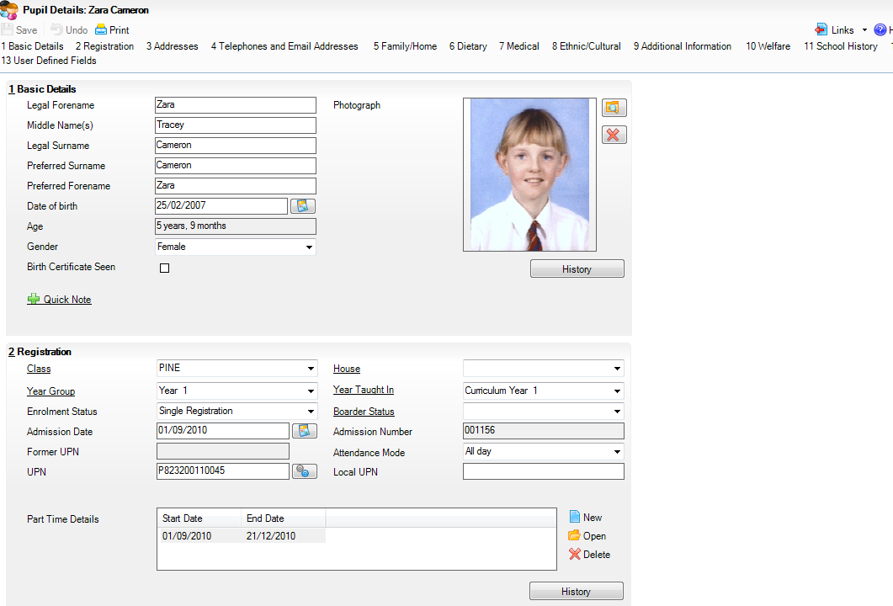
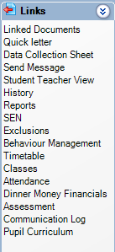
Pupil Level data in SIMS
Privacy Notice

Slide 14
Pupil Level data - Primary
UPN
Addresses
Free School Meals eligibility
Service Children
Ethnicity
First Language
English as an additional language
SEN
Attendance
Exclusions
Alternative Provision Placements
Young Carer Indicator

Slide 15
Pupil Level data - Secondary
UPN and ULN
Addresses
Free School Meals eligibility
Service Children
Ethnicity
First Language
English as an additional language
SEN
Learner Support Bursary
Youth Support Services Agreement
Attendance
Exclusions
Alternative Provision Placements
Young Carer Indicator

Slide 16
Pupil Level data not held on Pupil records – Primary Pupils
Statutory Return Tables / Census Panels
Class Type – Primary Schools
Early Years Hours – Nursery Pupils
Top up funding
Post Looked After Arrangements
Universal Infant Free School Meals taken
(School Dinner Taken – YR,1&2)
Funding & Monitoring (FAM) Tutoring Hours for Aut, Spr, Sum
Notes:
Put in statutory tables where possible as will then pull through into each return.
Top up Funding – additional funding for statemented or EHCP children. Application required – if approved then add to panel.

Slide 17
Early Years hours
No EY hours recorded for reception pupils
Funded Hours – Education hours (15hrs)
Extended Funded Childcare Hours (15hrs)
30 hour code to confirm eligibility for Ext FCH
Hours at Setting – not necessarily all funded
Disability Access Fund – Yes/No

Slide 18
Pupil Level data not held on Student records – Secondary
Statutory Return Tables or Census Panels
Top up funding
Post Looked After Arrangements
Funding and Monitoring Tuition Hours

Slide 19
School Level Data All Schools
Focus / School / School Details
School Contact details – email
School Type / Governance / Intake Type
School Time - All schools except Nursery

Slide 20
January Specific Data Items
Statutory Return Tables or Census Panels
Childcare – Spring
Classes and Student Reconciliation – Spring
FSM taken on Census Day – Spring
Admissions Appeals – Spring (Academies, Voluntary Aided and Foundation Schools)
EYPP Eligibility & 2 Year Old Basis for Funding – Nursery Pupils Spring

Slide 21
Historical – Includes leavers
Attendance –Autumn term
Exclusions –Sum & Aut term
Free school Meals – C day to C day
Learner Support 1/8/23 to C day
Census Week
Early Years hours
Current
On roll – enrolment status
Gender
SEN
First Lang, Ethnicity
Year groups
School details
Attendance - Part time
Census day
Childcare
Class Type
Top up funding
Post Looked After Arrangements
No of UIFSM taken
Classes & Pupil Reconciliation
Admissions Appeals
Free School Meals taken (Not UIFSM)
FAM hours

Slide 22
Before you create a new return you will need to:
Archive old census returns in the folder
Set up returns permissions, if required
Update Class types – primary schools
Update Early Years – for non Reception pupils under the age of 5 as at 31st August
Collate class activities for your selected period – Primary schools
Update Top up Funding
Update Post Looked After Arrangements
Update FAM information

Slide 23
Before you create a new return you will need to:
Check your fileset version number
…this can change!

Slide 24
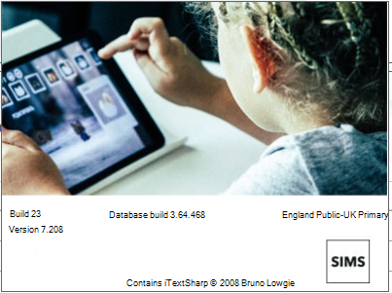
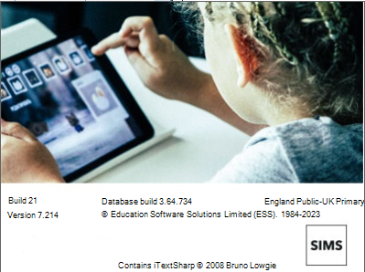
How to create and run a Census return...
SIMS .net
Version 7.214

Slide 25
What to do on Census Day –Thursday 18th January 2024
Open your ‘dry run’ census file extension UNA
Check details in all census panels
Add number of FSM taken on Census Day – All eligible pupils
Add number of UIFSM taken on Census Day – Infants only
Create and validate error free return
Check / print Detail Reports
Print Summary Report – get Head to sign
Make an electronic copy of census return
Authorise
Maintained schools submit return to Business Intelligence via School Upload website: http://apps.warwickshire.gov.uk/SchoolUpload
Academies submit return to the DfE via the COLLECT website: DfE Secure Sign-in

Slide 26
ICTDS SERVICE DESK (MIDAS)
01926 414100
ictdsservicedesk@warwickshire.gov.uk
Business Intelligence
01926 742169
businessintelligence@warwickshire.gov.uk
Notes:
School Census DEMO

